Slide 1


Indian Institute of Information Technology, Lucknow
Capstone
PROJECT
Team- YELLOW

Slide 2
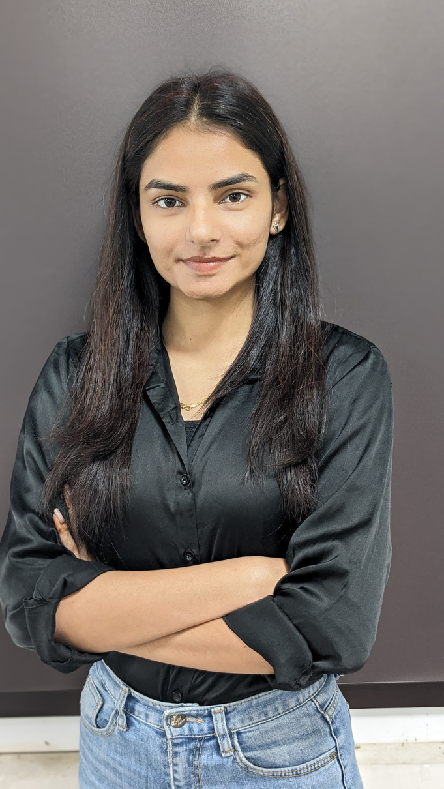
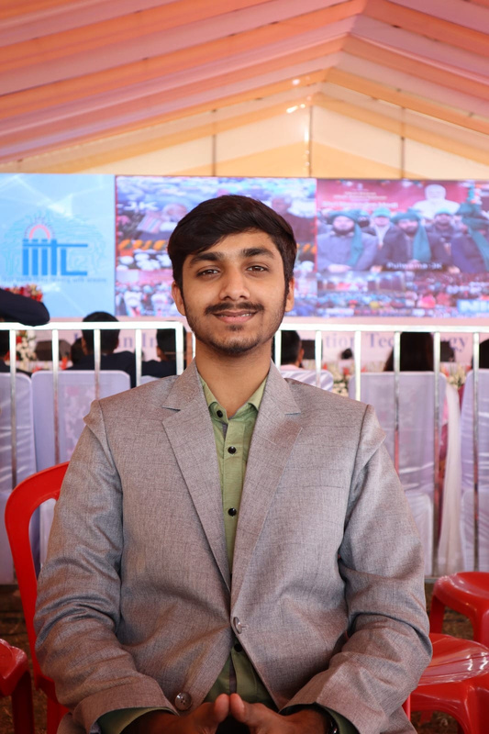
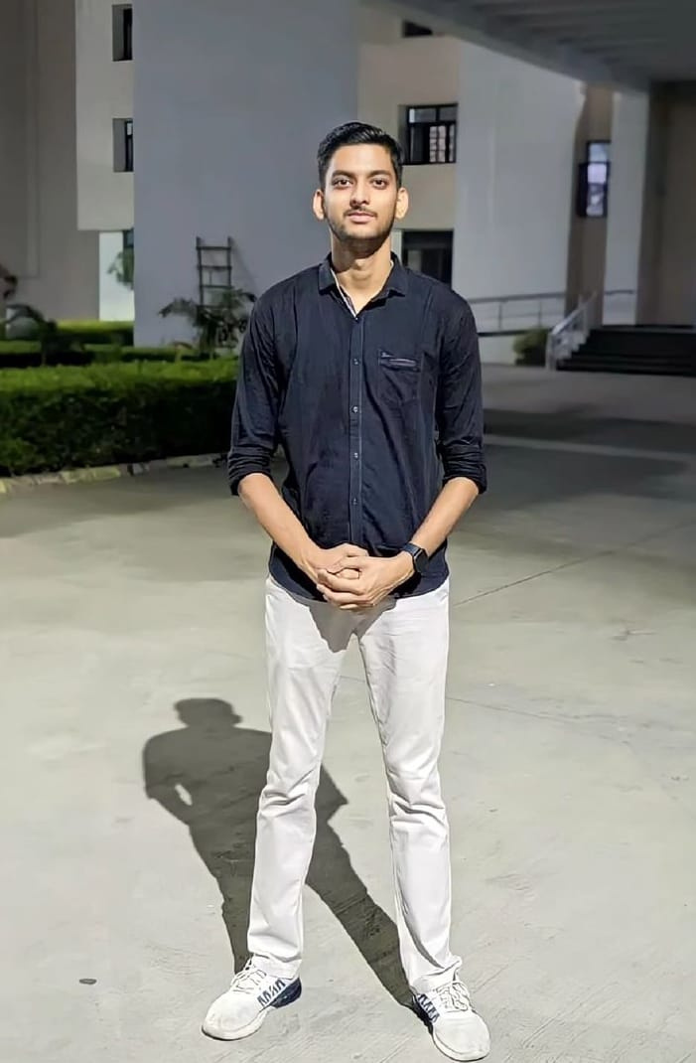

Meet
THE TEAM
Astha Awasthi
Tejas Srivastava
Utkarsh Kumar Pandey
MDB23010
MDB23020
MDB23030

Slide 3


Overview:
Founded after the dismantling of a mobile phone cartel.
Currently operates in the USA, Asia, and Europe.
Marketing strategies differ based on the market (the US prioritizes advertising, while Europe values features).
Primary Objective:
Maximize shareholder value
Secondary Measures:
Profitability, market share.
Company
INTRODUCTION

Slide 4

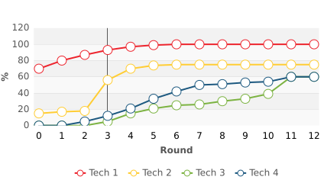
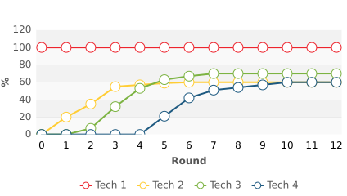
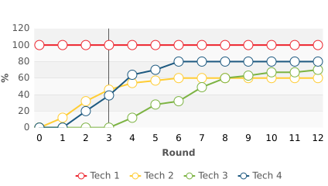
Network Coverage Forecast
USA
ASIA
EUROPE

Slide 5
Performance in
ROUND
6

Slide 6
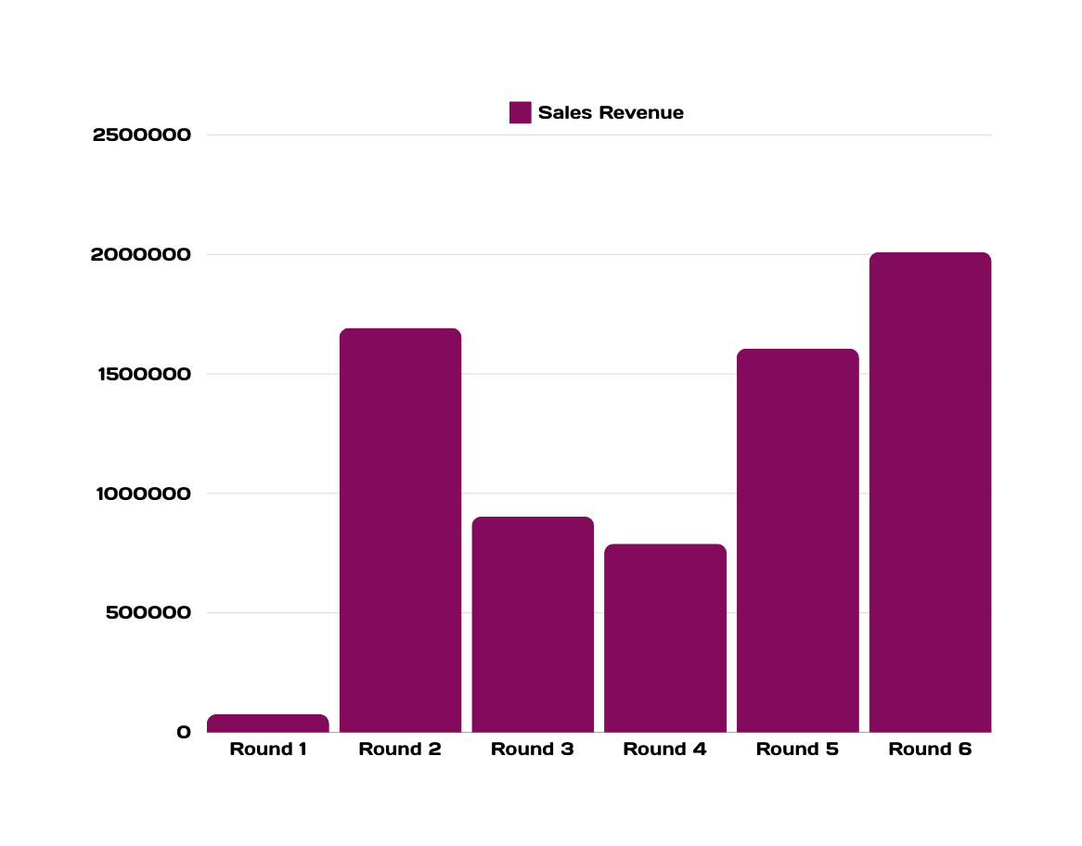
Sales Revenue
Peak sales revenue in Round 6
signifies sustained market growth and strong performance.

Slide 7
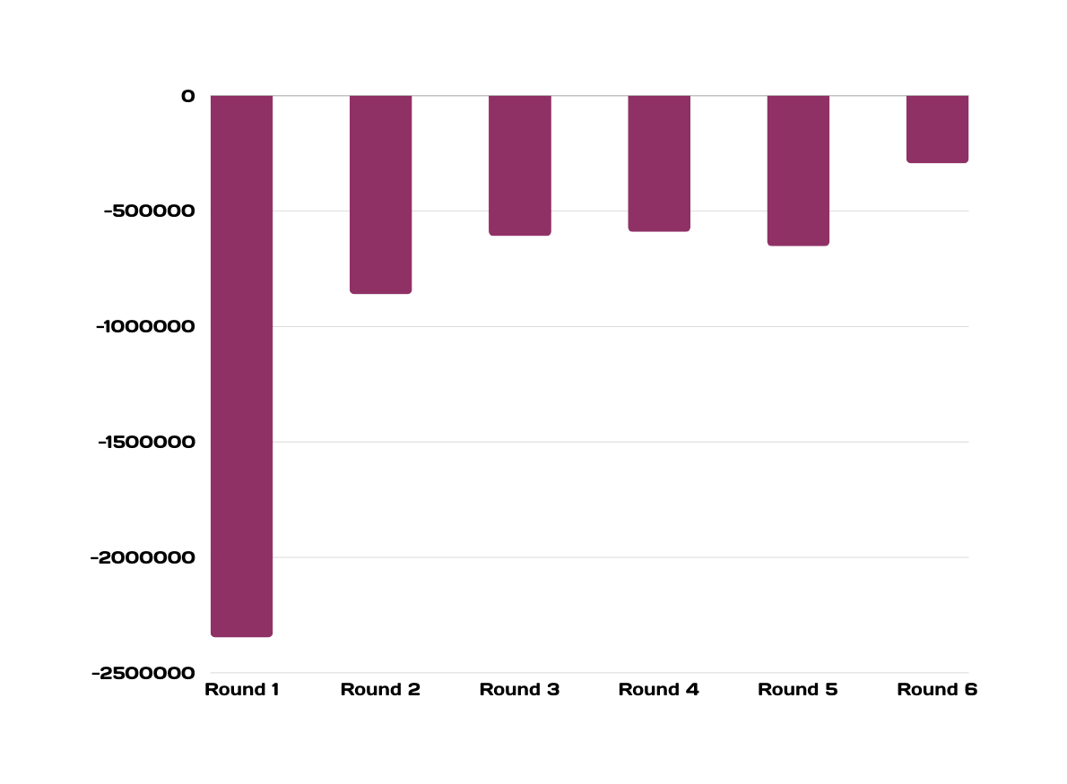

Profit
Losses Reduced by
87.50%

Slide 8
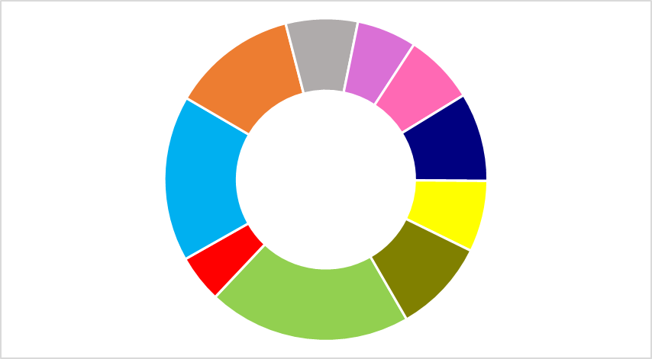
Global Market Share
6.73%
Tech 1
2.66%
Tech 2
13.64%
Tech 3
7.14%
Global Market share
6.26%
Tech 4

Slide 9
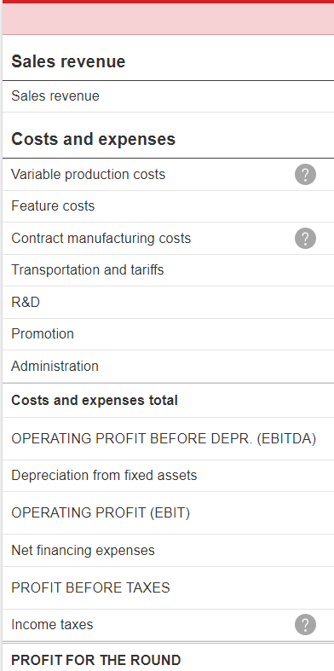
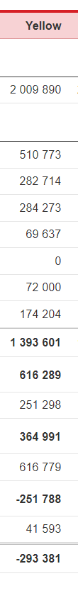
Profit and loss statement

Slide 10
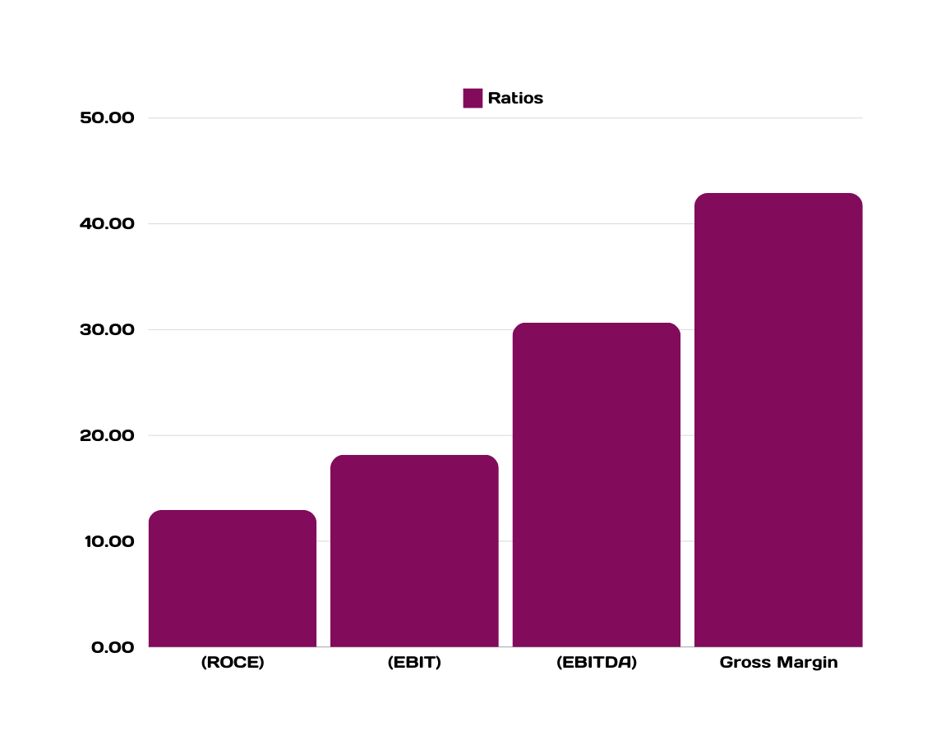
Ratios Analysis
Gross Margin of
42.91%
position us at 3rd among other
EBITDA is strong at
30.66%
Rank us at 4th postion

Slide 11
Overall performance

Slide 12
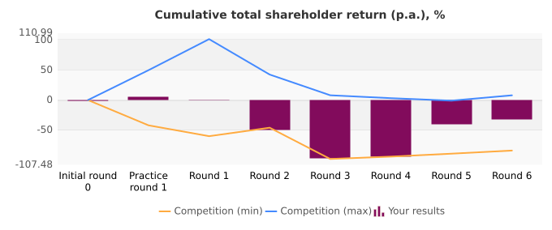
Cumulative Shareholder Return

Slide 13
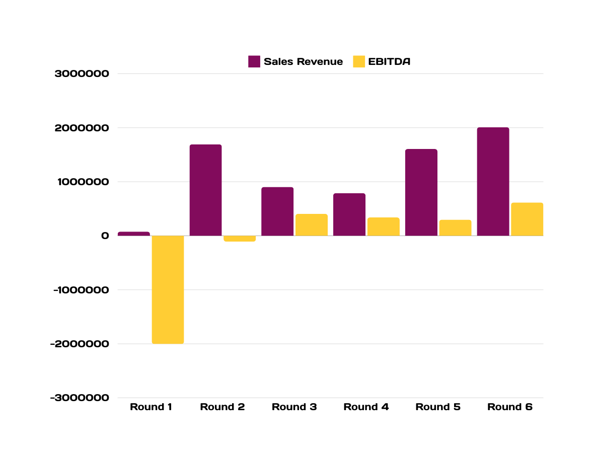
Sales Revenue and EBITDA
a positive EBITDA at Round 3
beginning of profitability and better operational control.

Slide 14
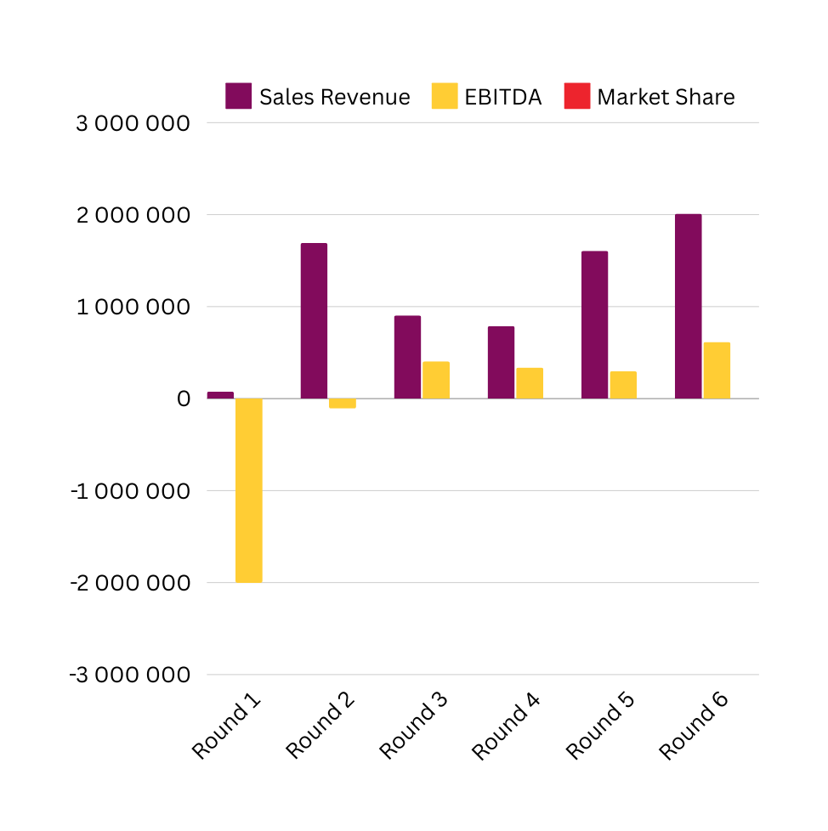

Overall Market Share
A positive correlation
between market share and sales revenue typically suggests effective market strategies.
Consistent market share in Rounds 4 and 5
indicates stable competitive positioning

Slide 15
IIIT, Lucknow
THANK YOU

